Slide 1
Agile Software Development

Slide 2
Agile Methodologies
Rapid development of small timeboxed subproducts of overall system
Iterative development
Quick responsiveness to changing requirements and customer needs

Slide 3
Metrics
Identifying, obtaining data for, computing, and using quantitative values to evaluate development performance
Key to identifying key goals and progress towards them
Key for stable, coordinated, and reliable development

Slide 4
However…
Agile processes emphasize individual interactions over processes, and software over documentation
This can lead to a deficiency of metrics to allow for a stable and coordinated development framework

Slide 5
The Bipartite Approach

Slide 6
Bipartite Approach
Agile development features two environments:
  Development team
  Project coordination and management
Approach – Keep metrics activity to a minimum within the team, but a significant activity within project management

Slide 7
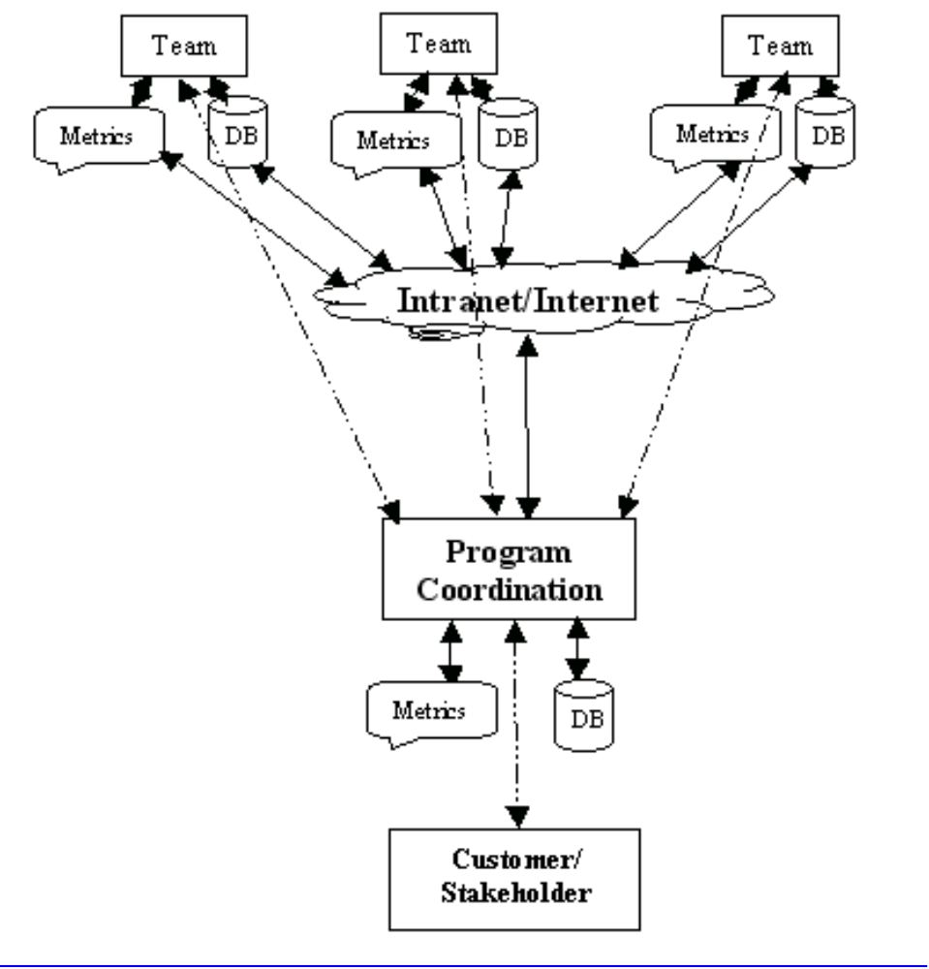

Slide 8
Metrics for Teams
Goals
  Address specific components being developed
  Focus on the short term (up to 30 days)
  Focus on specific requirements

Slide 9
Metrics for Teams
Questions
  What have we accomplished thus far?
  Are we on schedule?
  What inputs/outputs with other components do we need to address?
  Do our tests cover code and functionality?
  How is our testing proceeding?

Slide 10
Metrics for Teams
Features
  Small and simple configuration management systems
  Simple database for documentation and related artifacts
  Easily accessible list of requirements
  Easily accessible schedule
  Test-bank repository
  Simple bulletin board or collaboration software

Slide 11
Metrics for Project
Goals
  Keep up with ever-changing requirements
  Allow new and changed requirements to be easily translated into specific tasks for teams
  Emphasize interactions among components
  Consider customers and stakeholders
  Focus on entire development life cycle

Slide 12
Metrics for Project
Questions
  How have requirements changed and are we keeping up?
  What tasks have been distributed to teams, and what tasks have been accomplished?
  Have all interactions been accounted for?
  How is our product matching up to customer or market expectations?
  Does software possess systemic integrity and fitness for customer delivery?

Slide 13
Metrics for Project
Features
  Distributed repository system
  High-level configuration management system featuring tracking of parallel and mutually dependent applications and interfaces
  Complete requirements, documentation, team-coordination databases
  Overall schedules and team assignments
  Collaborative bulletin board system

Slide 14
Implementation

Slide 15
Agile Development Process (ADP)
Requirements specified in terms of stories.
  Encapsulated item of functionality
  Easily communicated and validated with customers and related stakeholders
  Implemented in no more than 2 person-weeks of development effort

Slide 16
Agile Development Process (ADP)
Stories are “batched” into a single 6-week cycle, each cycle to be completed by one team in two consecutive 3-week iteration cycles.
On average 5-6 iterations sufficient to supply overall functionality for a release.
Stories scheduled into cycles based on priority, risk, and need for learning and refactoring

Slide 17
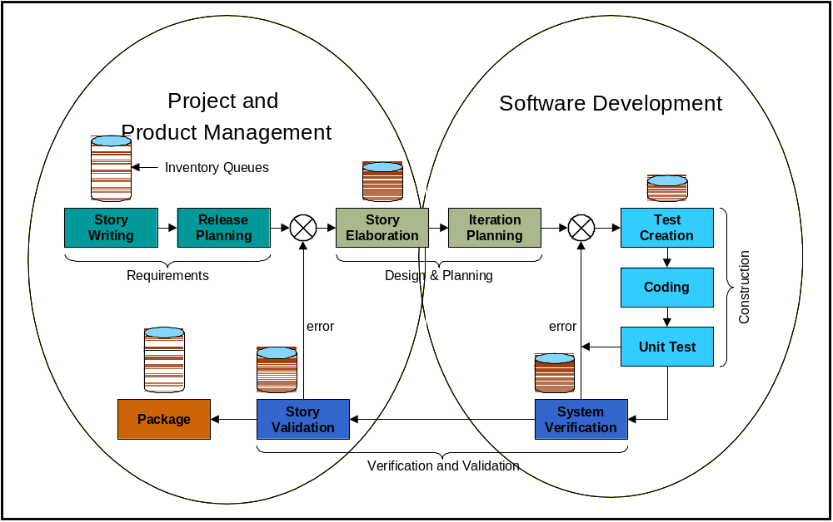

Slide 18
ADP Metrics Goals
Project Completion*
Level of Quality*
Ability to Change (content & priorities)
Ability to Integrate (cycle-products into seamless release)
* Addressed in this work

Slide 19
Sample Questions – Goal 1
What has a team accomplished thus far?
How is a team doing compared to its task commitments?
Are we on schedule relative to the current release backlog?
How fast is a team, or project as a whole, completing story development?

Slide 20
Sample Metrics – Goal 1
Story points
Story size
Story risk
Velocity
Complexity ratio
On-Time-Delivery (OTD)

Slide 21
Issues – Goal 1 Metrics
Contending with moving targets for planning and production
Tracking requirements changes

Slide 22
Sample Questions – Goal 2
How well does team product, or overall product, fulfill current requirements?
How well does a team’s product pass the QA tests specific to that product?
How well does the completed work pass integration and system test?
Does developed product possess systemic integrity and customer fitness?

Slide 23
Sample Metrics – Goal 2
Defect rates
Found-fixed ratio
Weighted quality percentage
Weighted quality percentage with confidence loss

Slide 24
Issues – Goal 2 Metrics
Timeliness and complexity of testing regimen – “Test First”
Impact of changing requirements on testing.

Slide 25
Conclusion

Slide 26
Summary
Metrics for team should be brief, focused, and short-term
Metrics for project management should be inclusive, encompass the project’s full complexity, and track through the project life
The two metrics areas complement each other. They not only coexist, but both must be present in the metrics design

Slide 27
Next Steps
Questions, metrics, and issues for Goals 3 and 4.
Further sophistication in data collection systems for bipartite agile metrics.
Further implementation of process improvements incorporating bipartite approach.

